Slide 1
How to make
MASTER FILTER in Tableau
(and make it relevant)
When we need to filter multiple data source, we need to do this because this FAQ(https://help.tableau.com/current/pro/desktop/en-us/filter_across_datasources.htm)
This FAQ not allow us to filter ‘A’ or ‘D’ from table X= [‘A’, ‘B’, ‘C’] blended table Y=[‘B’, ‘C’, ‘D’].
It’s just lock us to [‘B’, ‘C’] only.
So we need to build ‘MASTER TABLE’ that contain all Dimension first for make use of ‘blended data relation’ to gain ability to universal control all over our dashboard.
Below is step by step to set up this

Slide 2
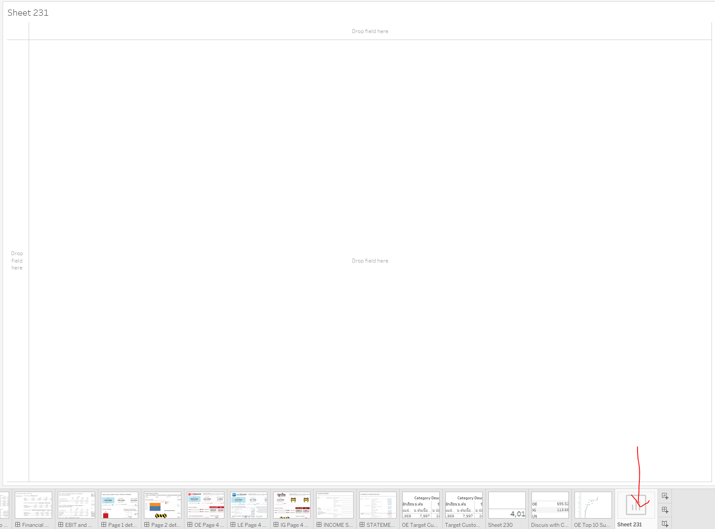
Step 1: create new worksheet
Don’t forget to rename it.
Not critical but when we have 100+ of worksheet,
We easily confuse and productivity drop as we need to find the right one.

Slide 3
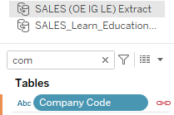
Step 2: Rename all field name to exactly match MASTER
copy field name from MASTER
and
paste by right click -> rename

Slide 4
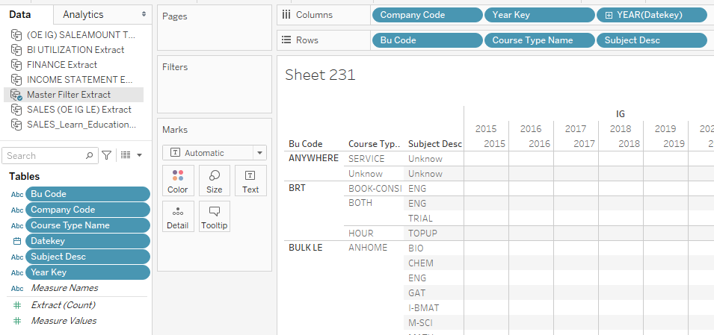
Step 3: Add all DIMENSION from MASTER TABLE
CAUTION: Add a dimension from "MASTER TABLE first" (to make it the primary source).
If not so "Relevant values only" are not displayed.

Slide 5
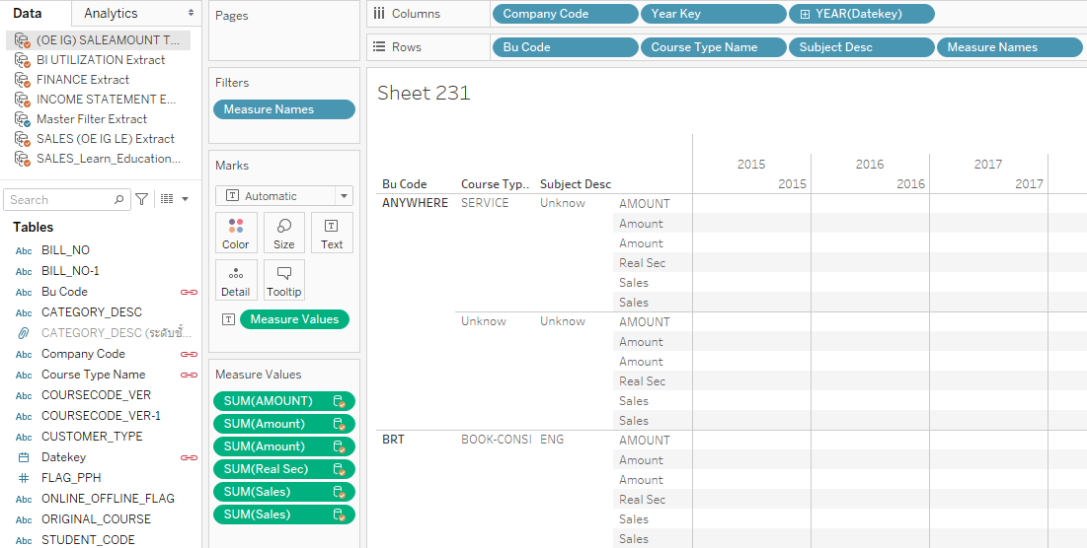
Step 4: Add Measure from all source
You don’t need to add all field, just 1 measure(from each table) is enough.
No need to place it’s right as this example, just add to worksheet.

Slide 6
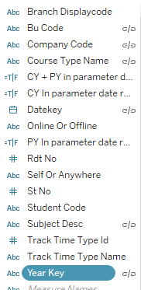
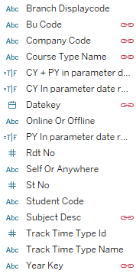
Step 5: Check data relation
Red chain will appear by your field name.
If it Gray then click it to make it red.
*If it did not appear at all then rename to match.

Slide 7
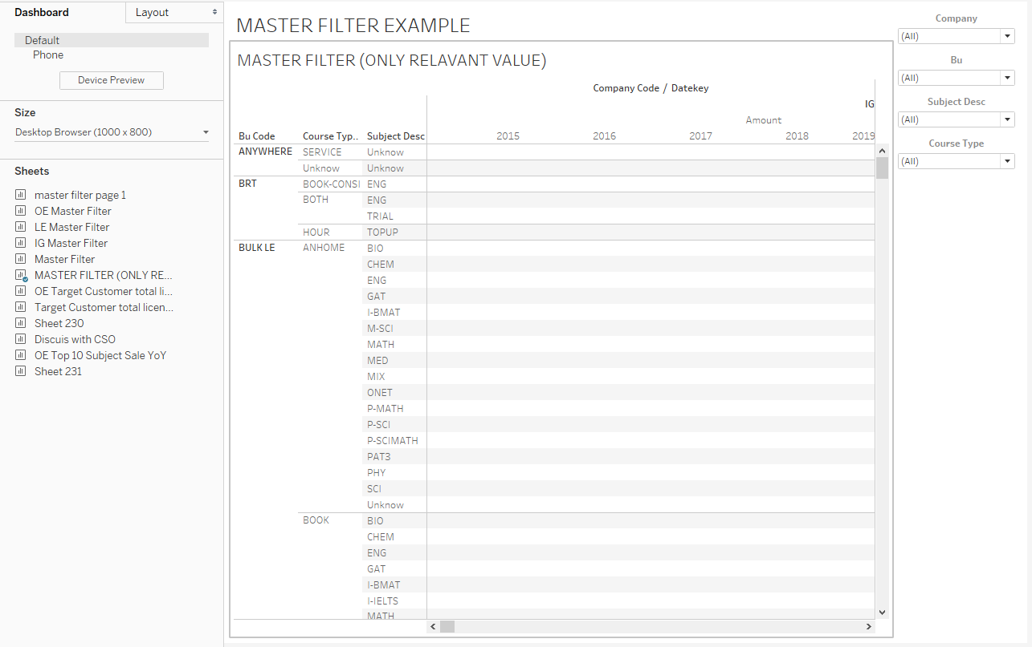
Step 6: Add ‘MASTER FILTER worksheet’ to dashboard
And set it to
‘Only Relevant value’

Slide 8
Step 7: Apply filter to worksheet you like
that's it, and please make sure to bring in master table dimensions first otherwise you need to reproduce this again or worse.
CAUTION : If ‘MASTER FILTER worksheet’ is removed from dashboard, the ability to select ONLY RELEVANT VALUE disappear. So do not remove it from dashboard, just hide all element and use it as blank space.

